Slide 1
Aakash Goel https://www.linkedin.com/in/goelaakash123/
Session 12:
Semantic Segmentation and CV Metrics
Acknowledgement: Slide Materials adopted from - Intro to Computer Vision (Cornell Tech); Noah Snavely, prepared by the lead instructor Prof S P Vimal , modified (added some content) by Aakash Goel

Slide 2
Convolutional Neural Network (CNN)
W₁
b₁
W₂
b₂
W₃
b₃
x
C
f(n)
C
f(n)
C
f(n)
Notes:
"Let's start by looking at the basic structure of a Convolutional Neural Network, or CNN. CNNs are designed to process data with a grid-like topology, such as images."
"The input image is passed through a series of layers, each performing a convolution operation. This is where the network learns to identify features like edges, textures, and more complex patterns."
"In the diagram, you can see the flow from the input (x) through convolutional layers (C) and activation functions (f(n))."
"Weights (W) and biases (b) are crucial as they are adjusted during training to minimize the error in predictions."

Slide 3
CNN
C
W
1
F
CNN
1
H
Function of the image that is parameterized by the convolutional filter weights and biases. We design the form of the function and fit the parameters to data.
Notes:
"CNNs work by parameterizing the image using convolutional filter weights and biases. This means the network learns a function that maps the input image to a desired output."
"We design the form of this function and fit the parameters to the data through training. This involves adjusting the weights and biases to minimize the loss."
"The transformation process involves converting an image with dimensions (Height, Width, Channels) into a feature vector (F), which is a compact representation of the image."

Slide 4
Now
C
F
W
W
CNN
H
H
Convert HxW image into a F-dimensional vector
Which pixels in this image are a cat?
How far is each pixel away from the camera?
Which pixels of this image are fake?
Notes:
"Here, we see the process of converting an HxW image into an F-dimensional vector using a CNN."
"This conversion allows us to ask interesting questions about the image, such as: Which pixels represent a cat? How far is each pixel from the camera? Which pixels might be fake?"
"These questions highlight the practical applications of CNNs in tasks like object detection, depth estimation, and image authenticity verification."

Slide 5
Semantic Segmentation
C
F
W
W
CNN
H
H
Today’s Running Example
Predict F-dimensional vector representing probability of each of F classes at every pixel
Loss computed/backprop’d at every pixel.
Notes:
"Semantic segmentation involves predicting an F-dimensional vector for each pixel in the image."
"Each vector represents the probability of each class at every pixel, allowing us to label each pixel with a class."
"The loss is computed and backpropagated at every pixel, which is crucial for training the network to accurately segment the image."

Slide 6
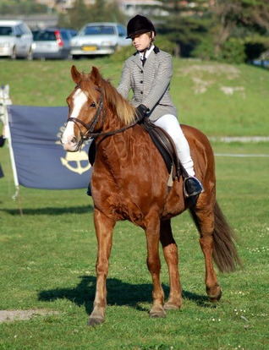

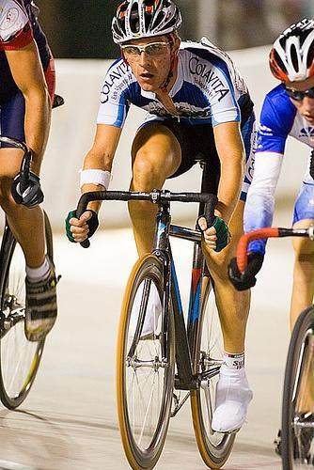
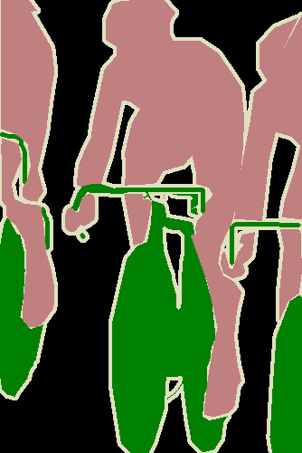
Semantic Segmentation
Each pixel has label
Usually visualized by colors.
Note: don’t distinguish between object instances
Input
Label
Input
Label
Image Credit: Everingham et al. Pascal VOC 2012.
Notes:
"In semantic segmentation, each pixel in an image is assigned a label, which is often visualized using different colors."
"As you can see in the examples, the input images are transformed into labeled outputs, where each color represents a different class."
"It's important to note that semantic segmentation does not distinguish between different instances of the same class."

Slide 7
Semantic Segmentation
“Semantic”: a usually meaningless word and an indication that someone is trying to trick you.
Meant to indicate here that we’re naming things.
Input
Label
Input
Label
Notes:
Understanding "Semantic"
"The term 'semantic' in semantic segmentation refers to the process of naming or classifying parts of an image."
"This involves identifying and labeling different parts of an image based on their class, such as 'horse,' 'rider,' or 'background.'"
"The goal is to provide a meaningful interpretation of the image by assigning a class label to each pixel."

Slide 8
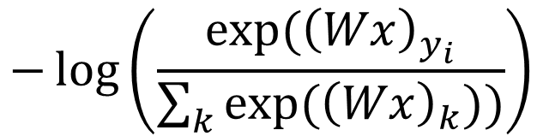
Semantic Segmentation
3
F
F
W
W
W
CNN
H
H
H
F-way classification loss function
at every pixel:
Image Credit: Everingham et al. Pascal VOC 2012.
Notes:
Semantic Segmentation Loss Function
"The loss function used in semantic segmentation is an F-way classification loss function."
"This involves computing the loss at every pixel using a formula that includes softmax and cross-entropy."
"The loss function helps the network learn to make accurate predictions by penalizing incorrect classifications."

Slide 9
Encoder-Decoder
Key idea: First downsample towards middle of network. Then upsample from middle.
How do we downsample?
Convolutions, pooling
C
F
W
W
H
H
Notes:
Encoder-Decoder Architecture
"The encoder-decoder architecture is a popular approach in semantic segmentation."
"The key idea is to first downsample the input towards the middle of the network and then upsample it back to the original resolution."
"Downsampling is achieved through convolutions and pooling, which help capture the essential features of the image while reducing its size."

Slide 10

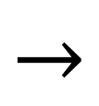
Where Do We Get Parameters?
Convnet that maps images to vectors
224
1x1
Recall that we can rewrite any vector-vector operations via 1x1 convolutions
Long et al. Fully Convolutional Networks For Semantic Segmentation. CVPR 2014
Notes:
Parameter Acquisition in CNNs
"In CNNs, parameters are obtained through a process that maps images to vectors."
"1x1 convolutions are used to rewrite vector-vector operations, simplifying the computations and reducing the number of parameters."
"This approach is particularly useful in fully convolutional networks, where the goal is to maintain spatial information throughout the network."

Slide 11
Where Do We Get Parameters?
Convnet that maps images to vectors
Convnet that maps images to images
224
224
1x1
1x1
What if we make the input bigger?
Notes:
Mapping Images to Vectors and Images
"Here, we compare CNNs that map images to vectors with those that map images to images."
"One question to consider is: What if we make the input bigger? How does this affect the network's performance and output?"
"Larger inputs can provide more detailed information, but they also require more computational resources and may lead to overfitting if not handled properly."

Slide 12
Where Do We Get Parameters?
Convnet that maps images to vectors
Convnet that maps images to images
224
500
1x1
10x10
Since it’s convolution, can reuse an image network
Notes:
Conclusion
"To wrap up, we've explored the key concepts of semantic segmentation and how CNNs are used to achieve this task."
"We've seen how CNNs transform images into feature vectors and how semantic segmentation assigns class labels to each pixel."
"I encourage you to explore further applications and challenges in this field, and feel free to ask any questions you might have."

Slide 13
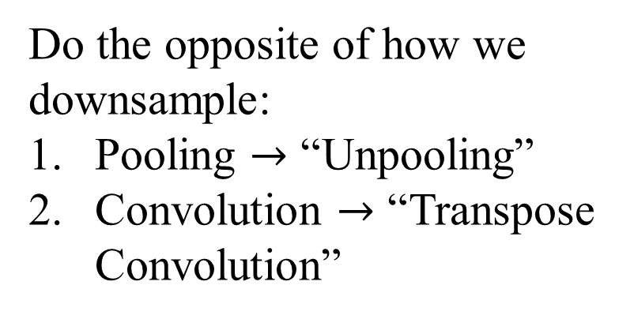
How Do We Upsample?
F
2W
C
W
2H
H
Notes:
How Do We Upsample?
"Now, let's talk about upsampling, which is essentially the reverse of downsampling."
"To upsample, we can use techniques like 'unpooling' and 'transpose convolution.'"
"Unpooling is the opposite of pooling, where we expand the feature map back to its original size."
"Transpose convolution, also known as deconvolution, is used to increase the spatial dimensions of the feature map."

Slide 14
Recall: Pooling
Max-pool
2x2 Filter
Stride 2
1
1
2
4
6
8
5
6
7
8
3
2
1
0
3
4
1
1
3
4
Notes:
Recall: Pooling
"Pooling is a crucial operation in CNNs that reduces the spatial dimensions of the input."
"Here, we see an example of max-pooling with a 2x2 filter and a stride of 2."
"Pooling helps in reducing the computational load and also makes the network invariant to small translations."

Slide 15
Now: Unpooling
Nearest NeighborUnpool
x2
6
6
8
8
6
8
6
6
8
8
3
4
3
3
4
4
3
3
4
4
Notes:
Now: Unpooling
"Unpooling is the process of reversing pooling operations to restore the original dimensions."
"In this example, we use nearest neighbor unpooling to expand the feature map by a factor of 2."
"Unpooling helps in reconstructing the spatial dimensions lost during pooling."

Slide 16
Recall: Convolution
3x3 Convolution, Stride 2, Pad 1
Dot product between filter f and input
Example Credit: L. Fei-Fei, J. Johnson, S. Yeung
Notes:
Recall: Convolution
"Let's revisit the concept of convolution, which is fundamental to CNNs."
"Here, we have a 3x3 convolution with a stride of 2 and padding of 1."
"The convolution operation involves computing the dot product between the filter and the input region."

Slide 17
Recall: Convolution
3x3 Convolution, Stride 2, Pad 1
Dot product between filter f and input
Example Credit: L. Fei-Fei, J. Johnson, S. Yeung
Notes:
Recall: Convolution (Continued)
"In this slide, we see how multiple filters can be applied to the same input region."
"Each filter extracts different features from the input, contributing to the richness of the feature map."

Slide 19
Recall: Convolution
3x3 Convolution, Stride 2, Pad 1
Example Credit: L. Fei-Fei, J. Johnson, S. Yeung
Notes:
Recall: Convolution (Further)
"As we continue, notice how the convolution operation slides over the input, applying the filter at each step."
"This process generates a feature map that captures spatial hierarchies in the input data."

Slide 20
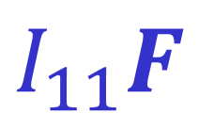
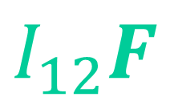
Transpose Convolution
3x3 Transpose Convolution, Stride 2, Pad 1
Output is filter F weighted by input I
I11
I12
Example Credit: L. Fei-Fei, J. Johnson, S. Yeung
Notes:
Transpose Convolution
"Transpose convolution is used to increase the spatial dimensions of the feature map."
"In this operation, the output is generated by weighting the filter with the input values."
"This technique is essential for tasks like semantic segmentation, where we need to produce high-resolution outputs."

Slide 21
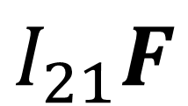
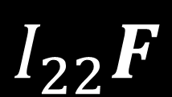
Transpose Convolution
3x3 Transpose Convolution, Stride 2, Pad 1
Output is filter F weighted by input I
I11
I12
I21
I22
Sum outputs at overlap (e.g., from I₁₁F and I₂₁F)
Example Credit: L. Fei-Fei, J. Johnson, S. Yeung
Notes:
Transpose Convolution (Continued)
"When performing transpose convolution, overlapping regions in the output are summed."
"This slide illustrates how the outputs from different input positions are combined to form the final feature map."

Slide 22
Putting it Together
Convolutions + pooling downsample/compress/encode
Transpose convs./unpoolings upsample/uncompress/decode
Input
Downsample
Conv, pool
“Encoder”
Upsample
Tr. Conv./Unpool
“Decoder”
Output
C
F
W
W
H
H
Notes:
Putting it Together
"Let's put everything together to understand the complete process."
"In an encoder-decoder architecture, convolutions and pooling are used to downsample or compress the input, forming the 'encoder' part."
"Transpose convolutions and unpooling are used to upsample or decompress the feature map, forming the 'decoder' part."
"This architecture is powerful for tasks like semantic segmentation, where we need to maintain spatial information while processing the image."

Slide 23
Putting It Together – Block Sizes
Networks come in lots of forms
Don’t take any block sizes literally.
Often (not always) keep some spatial resolution
Encode to spatially smaller tensor, then decode.
Encode to 1D vector then decode
Notes:
Putting It Together – Block Sizes
"When designing neural networks, it's important to remember that they come in various forms and configurations."
"Don't take any block sizes literally; they are often flexible and can be adjusted based on the task."
"Typically, networks maintain some spatial resolution throughout the layers, but this isn't always the case."
"On the left, we see an example of encoding to a smaller spatial tensor before decoding, while on the right, the network encodes to a 1D vector before decoding."

Slide 24
Putting It Together – Block Sizes
Often multiple layers at each spatial resolution.
Often halve spatial resolution and double feature depth every few layers
H
W
D
H/2 W/2
2D
H/4
W/4
4D
H/8
W/8
8D
H/4
W/4
4D
H/2 W/2
2D
H
W
D
Notes:
Putting It Together – Block Sizes (Continued)
"In many networks, you'll find multiple layers at each spatial resolution."
"It's common to halve the spatial resolution and double the feature depth every few layers, as shown here."
"This approach helps in capturing more complex features while reducing the spatial dimensions, which is efficient for computation."

Slide 25
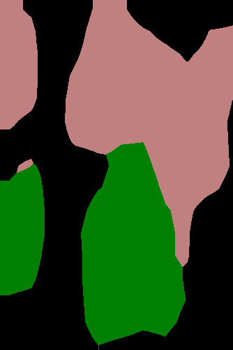
Missing Details
While the output is HxW, just upsampling often produces results without details/not aligned with the image.
Why?
Information about details lost when downsampling!
Result from Long et al. Fully Convolutional Networks For Semantic Segmentation. CVPR 2014
Notes:
Missing Details
"While the output may have the same height and width as the input, simply upsampling can lead to results that lack detail or are not well-aligned with the original image."
"This happens because information about fine details is often lost during the downsampling process."
"Understanding why this occurs is crucial for improving the accuracy of semantic segmentation models."

Slide 26
Missing Details
Where is the useful information about the high-frequency details of the image?
A
B
C
D
E
Result from Long et al. Fully Convolutional Networks For Semantic Segmentation. CVPR 2014
Notes:
Missing Details (Continued)
"The question we need to address is: Where is the useful information about the high-frequency details of the image?"
"As we move through the network, we need to ensure that important details are preserved or reconstructed in the output."

Slide 27
Missing Details
How do you send details forward in the network?
You copy the activations forward.
Subsequent layers at the same resolution figure out how to fuse things.
Copy
Result from Long et al. Fully Convolutional Networks For Semantic Segmentation. CVPR 2014
Notes:
Missing Details – Copying Details Forward
"One way to preserve details is by copying activations forward in the network."
"By doing this, subsequent layers at the same resolution can figure out how to fuse these details effectively."
"This technique helps in maintaining the integrity of high-frequency details throughout the network."

Slide 28
U-Net
Extremely
popular
architecture, was originally used for biomedical image segmentation.
Ronneberger et al. “U-Net: Convolutional Networks for Biomedical Image Segmentation. MICCAI 2015
Notes:
U-Net
"U-Net is an extremely popular architecture, originally developed for biomedical image segmentation."
"It features a symmetric encoder-decoder structure with skip connections that help retain spatial information."
"These skip connections allow the network to combine low-level features with high-level features, improving segmentation accuracy."

Slide 29
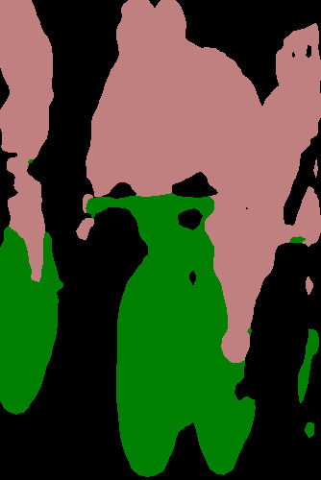
Evaluating Pixel Labels
Input Image
Predicted Classes
F
F
W
W
CNN
H
H
How do we convert final HxWxF into labels?
argmax over labels
Notes:
Evaluating Pixel Labels
"Once we have the final output from the CNN, we need to convert it into labels for each pixel."
"This is done using an argmax operation over the labels, which selects the class with the highest probability for each pixel."
"The result is a segmented image where each pixel is assigned to a predicted class."

Slide 30
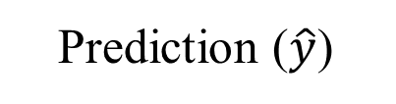
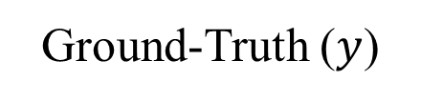
Evaluating Semantic Segmentation
Given predictions, how well did we do?
Input
Notes:
Evaluating Semantic Segmentation
"To evaluate the performance of our semantic segmentation model, we compare the predicted labels with the ground truth."
"Here, we see the input image, the model's prediction, and the ground truth side by side."
"By analyzing these results, we can assess how well the model is performing and identify areas for improvement."

Slide 31
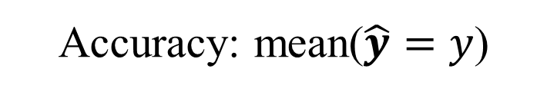
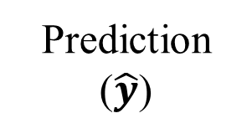
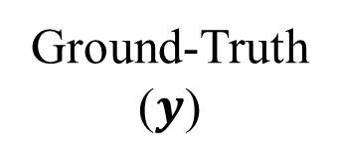
Evaluating Semantic Segmentation
Prediction and ground-truth are images where each pixel is one of F classes.
Intersection over union, averaged over classes
/
Notes:
"In semantic segmentation, both the prediction and ground truth are images where each pixel is assigned one of F classes."
"To evaluate the accuracy, we calculate the mean of correctly predicted pixels, denoted as mean(ŷ = y)."
"Another important metric is Intersection over Union (IoU), which is averaged over all classes. It measures the overlap between the predicted and true regions."

Slide 32
Aside.

Slide 33

Why “Transpose Convolution”?
Can write convolution as matrix-multiply
Input: 4, Filter: 3, Stride: 1, Pad: 1
a
b
c
d
x
y
z
0
x
y
z
0
0
0
ay+bz
a
0
x
y
z
0
0
x
=
ax+by+cz
b
0
0
x
y
z
0
c
bx+cy+dz
0
0
0
x
y
z
d
cx+dy
0
Example Credit: L. Fei-Fei, J. Johnson, S. Yeung
Notes:
Why "Transpose Convolution"?
"Transpose convolution can be understood as a way to perform convolution operations in reverse."
"Here, we see how a standard convolution can be expressed as a matrix multiplication."
"The input, filter, stride, and padding are used to compute the output through this matrix operation."

Slide 34
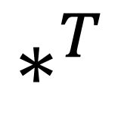
Why “Transpose Convolution”?
Transpose convolution is convolution transposed
a
b
c
d
x
y
z
0
0
0
x
ax
ax
0
0
x
y
ay+bx
ay+
bx
a
x
=
…
0
x
y
z
b
az+by+cx
az+
by+
x
y
z
0
c
bz+cy+dx
bz+
…
y
z
0
0
d
cz+dy
…
z
0
0
0
dz
Example Credit: L. Fei-Fei, J. Johnson, S. Yeung
Notes:
Why "Transpose Convolution"? (Continued)
"Transpose convolution is essentially the transposed version of a standard convolution."
"This operation allows us to increase the spatial dimensions of the input, which is crucial for tasks like upsampling in semantic segmentation."
"The transposed matrix operation helps in reconstructing the spatial structure of the input."

Slide 35
Performance Metrics for Segmentation - see materials
Notes:
Performance Metrics for Segmentation
"For a deeper understanding of performance metrics used in segmentation, please refer to the additional materials provided."
"These materials will cover various metrics and their applications in evaluating segmentation models."

Slide 36
mAP for Object Detection
Source: Karel Hora
Brno University of Technology / Czech Technical University in Prague
horak@feec.vutbr.cz
Notes:
mAP for Object Detection
"Now, let's shift our focus to object detection and discuss the metric known as mean Average Precision (mAP)."
"This metric is widely used to evaluate the performance of object detectors like Faster R-CNN and SSD."

Slide 37
mAP for Object Detection
mAP stands for mean Average Precision.
AP is a popular metric in measuring the accuracy of object detectors like Faster R-CNN, SSD, etc.
Average precision computes the average precision value for recall value over 0 to 1. It sounds complicated but actually pretty simple as we illustrate it with an example.
But before that, we will do a quick recap on precision, recall, and IoU first.
Notes:
mAP for Object Detection (Continued)
"mAP stands for mean Average Precision, a popular metric for measuring the accuracy of object detectors."
"Average Precision (AP) computes the average precision value for recall values ranging from 0 to 1."
"Before diving into mAP, we'll quickly recap precision, recall, and Intersection over Union (IoU)."

Slide 38
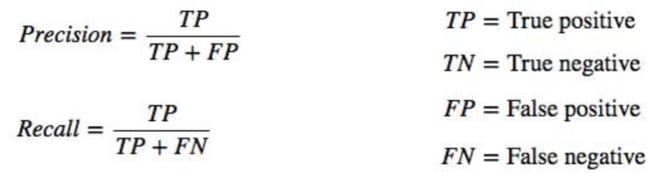

Precision & recall
Precision measures how accurate is your predictions. i.e. the percentage of your predictions are correct.
Recall measures how good you find all the positives. For example, we can find 80% of the possible positive cases in our top K predictions.
F1 score is a measure combining Precision and Recall.
Notes:
Precision & Recall
"Precision measures the accuracy of your predictions, specifically the percentage of correct predictions."
"Recall measures how well you identify all positive instances. For example, finding 80% of possible positives in your top predictions."
"The F1 score combines precision and recall, providing a balanced measure of a model's performance."

Slide 39
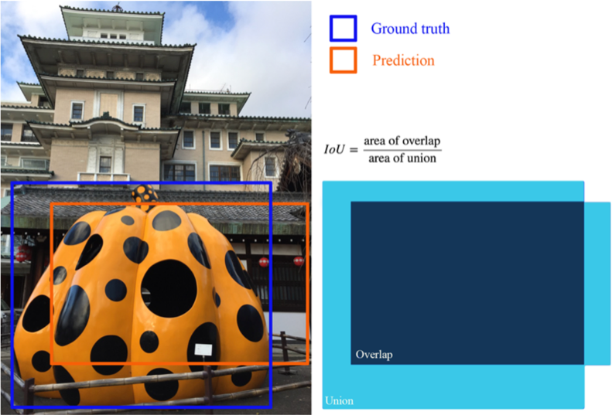
IoU (Intersection over union)
IoU measures the overlap between two boundaries.
We use that to measure how much our predicted boundary overlaps with the ground truth (the real object boundary).
In some datasets, we predefine an IoU threshold (say 0.5) in classifying whether the prediction is a true positive or a false positive.
Notes:
IoU (Intersection over Union)
"IoU measures the overlap between two boundaries, such as predicted and ground truth boundaries."
"It's used to assess how much the predicted boundary overlaps with the actual object boundary."
"In some datasets, an IoU threshold is predefined to classify predictions as true or false positives."

Slide 40
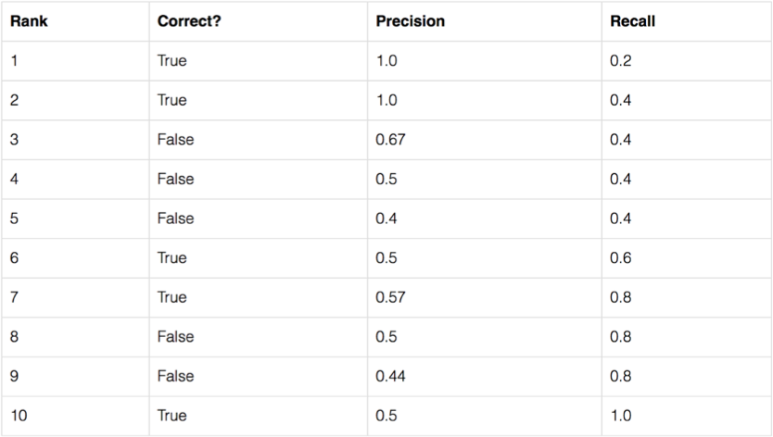
Average Precision
Let us create an over-simplified example in demonstrating the calculation of the average precision.
In this example, the whole dataset contains five apples only. We collect all the predictions made for apples in all the images and rank it in descending order according to the predicted confidence level. The second column indicates whether the prediction is correct or not. In this example, the prediction is correct if IoU ≥ 0.5.
Notes:
Average Precision
"Let's look at an example to understand how average precision is calculated."
"In this simplified example, we rank predictions for apples based on confidence levels and determine correctness using an IoU threshold of 0.5."

Slide 41
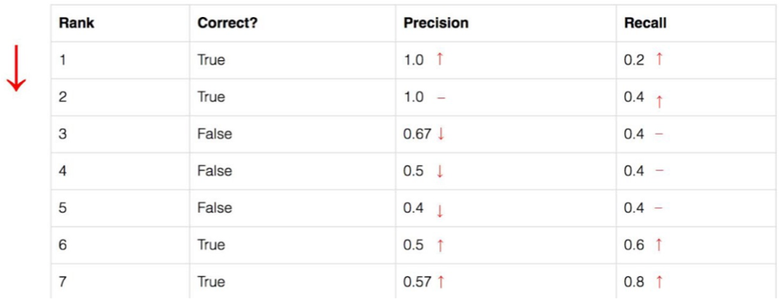
Average Precision
Let us take the row with rank #3 and demonstrate how precision and recall are calculated first.
Precision is the proportion of TP = 2/3 = 0.67.
Recall is the proportion of TP out of the possible positives = 2/5 = 0.4.
Recall values increase as we go down the prediction ranking. However, precision has a zigzag pattern
— it goes down with false positives and goes up again with true positives.
Notes:
Average Precision (Continued)
"Taking the row with rank #3, we calculate precision as the proportion of true positives, which is 2/3 or 0.67."
"Recall is the proportion of true positives out of all possible positives, calculated as 2/5 or 0.4."
"As we move down the ranking, recall values increase, while precision may fluctuate due to false positives."

Slide 42
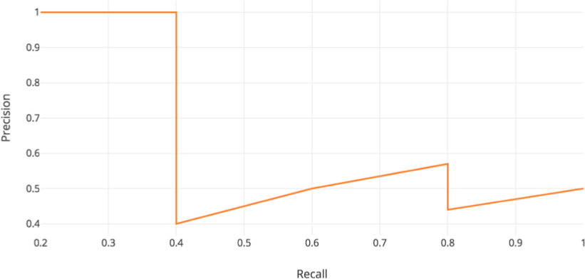

Average Precision
Let us plot the precision against the recall value to see this zig-zag pattern.
The general definition for the Average Precision (AP) is finding the area under the precision-recall curve.
Notes:
Average Precision
"Let's visualize the relationship between precision and recall by plotting them to observe the zig-zag pattern."
"The general definition of Average Precision (AP) involves finding the area under the precision-recall curve."
"This area gives us a single value that summarizes the trade-off between precision and recall across different thresholds."

Slide 43
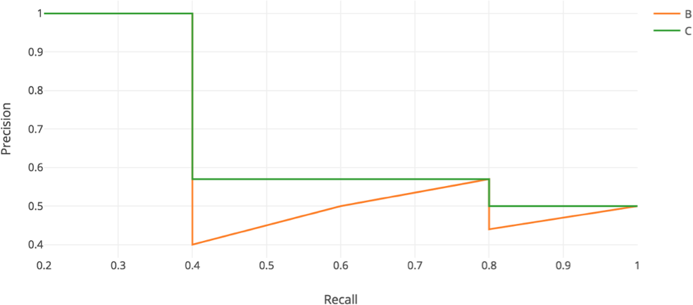
Average Precision
Precision and recall are always between 0 and 1. Therefore, AP falls within 0 and 1 also.
Before calculating AP for the object detection, we often smooth out the zigzag pattern first.
Graphically, at each recall level, we replace each precision value with the maximum precision value to the right of that recall level.
Notes:
Average Precision (Continued)
"Precision and recall values range between 0 and 1, so AP also falls within this range."
"Before calculating AP, we often smooth out the zig-zag pattern in the precision-recall curve."
"Graphically, this involves replacing each precision value with the maximum precision value to the right of that recall level."

Slide 44
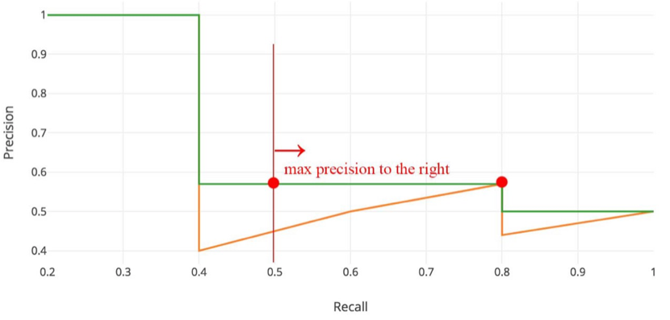

Average Precision
So the orange line is transformed into the green line and the curve will decrease monotonically instead of the zigzag pattern.
The calculated AP value will be less susceptible to small variations in the ranking.
Mathematically, we replace the precision value for recall ȓ with the maximum precision for any recall
≥ ȓ.
Notes:
Average Precision (Further)
"By transforming the orange line into the green line, the curve decreases monotonically instead of zig-zagging."
"This smoothing makes the AP value less sensitive to small variations in the ranking."
"Mathematically, we replace the precision value for recall r with the maximum precision for any recall greater than or equal to r."

Slide 45
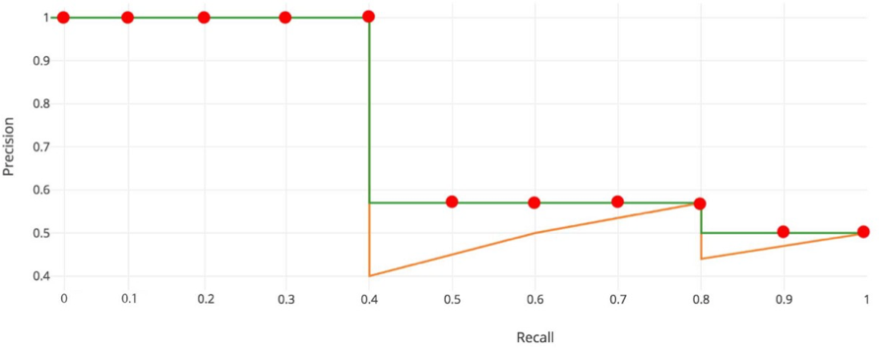
Interpolated AP
PASCAL VOC is a popular dataset for object detection.
For the PASCAL VOC challenge, a prediction is positive if IoU ≥ 0.5. Also, if multiple detections of the same object are detected, it counts the first one as a positive while the rest as negatives.
In Pascal VOC2008, an average for the 11-point interpolated AP is calculated.
Notes:
Interpolated AP
"PASCAL VOC is a well-known dataset for object detection, and it uses specific criteria for evaluating predictions."
"For the PASCAL VOC challenge, a prediction is considered positive if IoU is greater than or equal to 0.5."
"In PASCAL VOC2008, an average for the 11-point interpolated AP is calculated to evaluate performance."

Slide 46


Interpolated AP
First, we divide the recall value from 0 to 1.0 into 11 points — 0, 0.1, 0.2, …, 0.9 and 1.0.
Next, we compute the average of maximum precision value for these 11 recall values.
In our example, AP = (5 × 1.0 + 4 × 0.57 + 2 × 0.5)/11
Notes:
Interpolated AP (Continued)
"To calculate interpolated AP, we divide the recall range from 0 to 1 into 11 points."
"We then compute the average of the maximum precision values at these recall points."
"In our example, the AP is calculated as the average of these maximum precision values."

Slide 47
Interpolated AP
When APᵣ turns extremely small, we can assume the remaining terms to be zero. i.e. we do not necessarily make predictions until the recall reaches 100%.
If the possible maximum precision levels drop to a negligible level, we can stop.
For 20 different classes in PASCAL VOC, we compute an AP for every class and also provide an average for those 20 AP results.
However, this interpolated method is an approximation which suffers two issues:
It is less precise.
Second, it lost the capability in measuring the difference for methods with low AP.
Therefore, a different AP calculation is adopted after 2008 for PASCAL VOC.
Notes:
Interpolated AP (Further)
"When the AP value becomes very small, we can assume the remaining terms are negligible."
"This means we don't need to make predictions until recall reaches 100%."
"The interpolated method has limitations, such as being less precise and losing the ability to differentiate methods with low AP."

Slide 48
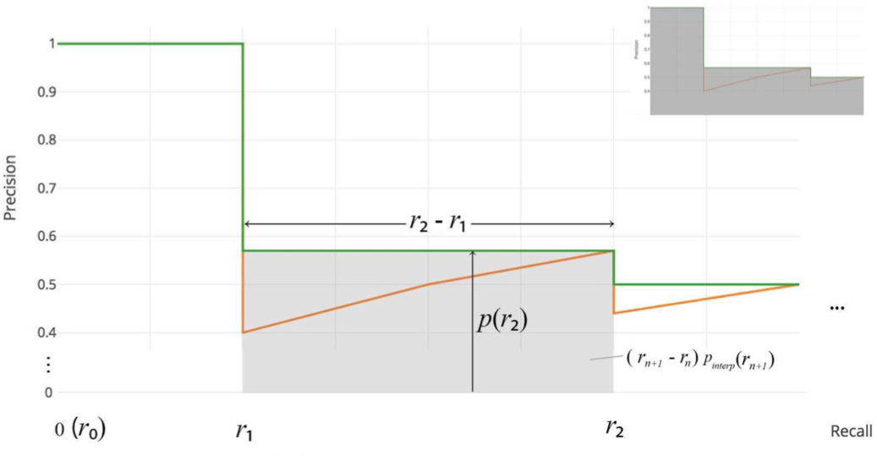
AP (Area under curve AUC)
For later Pascal VOC competitions, VOC2010–2012 samples the curve at all unique recall values (r₁, r₂, …), whenever the maximum precision value drops.
With this change, we are measuring the exact area under the precision-recall curve after the zigzags are removed.
Notes:
AP (Area under Curve AUC)
"For later Pascal VOC competitions, the curve is sampled at all unique recall values whenever the maximum precision value drops."
"This change allows us to measure the exact area under the precision-recall curve after removing zigzags."

Slide 49
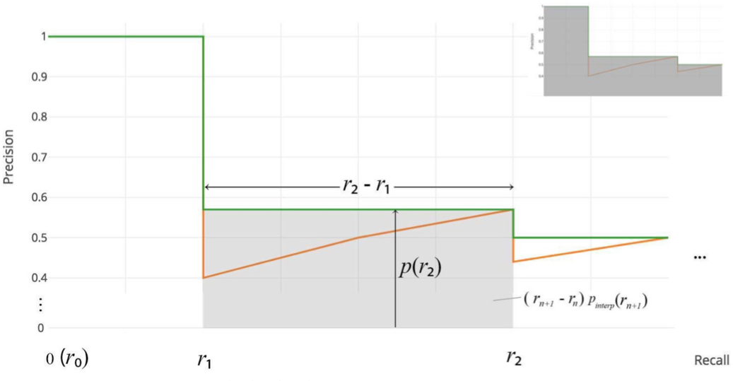
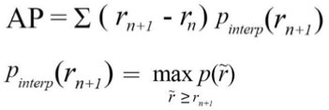
AP (Area under curve AUC)
No approximation or interpolation is needed.
Instead of sampling 11 points, we sample p(rᵢ) whenever it drops and computes AP as the sum of the rectangular blocks.
Notes:
AP (Area under Curve AUC) (Continued)
"No approximation or interpolation is needed with this method."
"Instead of sampling 11 points, we sample whenever precision drops and compute AP as the sum of rectangular blocks."

Slide 50
COCO mAP
Latest research papers tend to give results for the COCO dataset only. In COCO mAP, a 101-point interpolated AP definition is used in the calculation.
For COCO, AP is the average over multiple IoU (the minimum IoU to consider a positive match).
AP@[.5:.95] corresponds to the average AP for IoU from 0.5 to 0.95 with a step size of 0.05.
For the COCO competition, AP is the average over 10 IoU levels on 80 categories (AP@[.50:.05:.95]: start from 0.5 to 0.95 with a step size of 0.05).
Notes:
COCO mAP
"In recent research, results are often reported for the COCO dataset using a 101-point interpolated AP definition."
"For COCO, AP is averaged over multiple IoU thresholds, from 0.5 to 0.95, with a step size of 0.05."
"This comprehensive evaluation provides a more detailed assessment of model performance across different IoU levels."

Slide 51
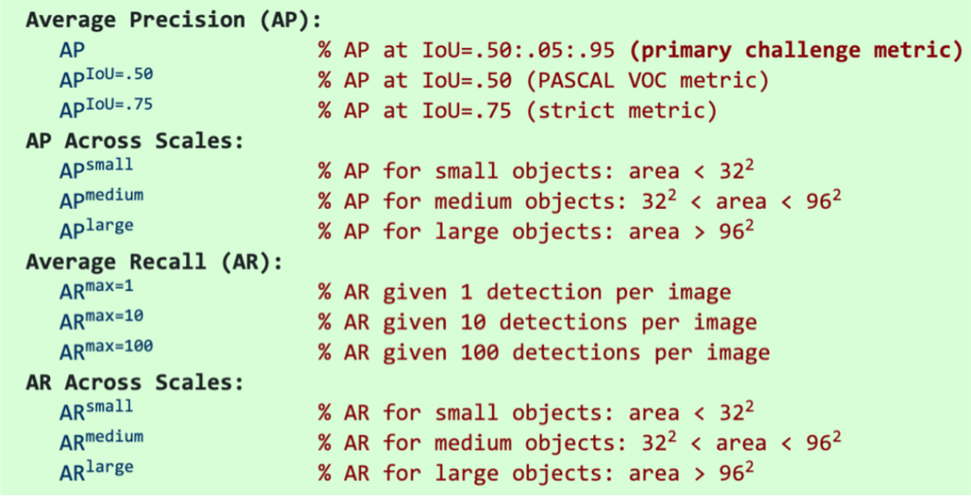
COCO mAP
The following are some other metrics collected for the COCO dataset:
Notes:
COCO mAP (Continued)
"The COCO dataset also includes other metrics, such as AP across scales and average recall (AR) for different object sizes."
"These metrics help evaluate model performance on small, medium, and large objects, as well as the ability to detect multiple objects per image."

Slide 52
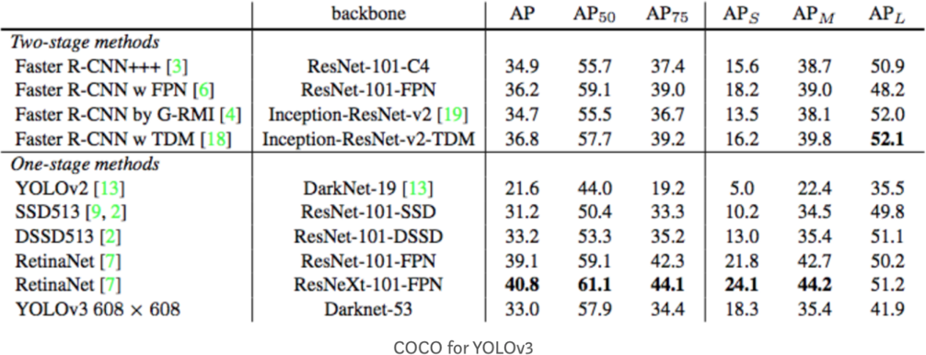
COCO mAP
Example: the AP result for the YOLOv3 detector:
For clarity, AP@.75 means the AP with IoU=0.75.
Notes:
COCO mAP
"Let's look at an example of the Average Precision (AP) results for the YOLOv3 detector on the COCO dataset."
"The table shows AP results across different IoU thresholds, such as AP@50 and AP@75, as well as for different object sizes (small, medium, large)."
"For clarity, AP@.75 refers to the AP calculated with an IoU threshold of 0.75."
"This table also compares the performance of YOLOv3 with other methods, highlighting the effectiveness of different backbones and configurations."

Slide 53
COCO mAP
mAP (mean average precision) is the average of AP.
In some context, we compute the AP for each class and average them. But in some context, they mean the same thing. For example, under the COCO context, there is no difference between AP and mAP. Here is the direct quote from COCO:
„AP is averaged over all categories. Traditionally, this is called “mean average precision” (mAP). We make no distinction between AP and mAP (and likewise AR and mAR) and assume the difference is clear from context.“
In ImageNet, the AUC method is used.
To summarize: even all of them follow the same principle in measurement AP, the exact calculation may vary according to the datasets. Fortunately, development kits are available in calculating this metric.
Notes:
COCO mAP (Continued)
"mAP, or mean Average Precision, is essentially the average of AP values across different classes or categories."
"In some contexts, AP and mAP are used interchangeably, especially under the COCO context where they mean the same thing."
"The COCO dataset averages AP over all categories, and this is traditionally referred to as mAP."
"In other datasets like ImageNet, the AUC (Area Under Curve) method is used for evaluation."
"To summarize, while the principle of measuring AP is consistent, the exact calculation can vary depending on the dataset. Fortunately, development kits are available to help calculate these metrics accurately."

Slide 54
Summary
Understanding CNNs and Semantic Segmentation:
We explored the structure and functionality of Convolutional Neural Networks (CNNs) and their application in semantic segmentation.
We learned how CNNs transform input images into feature maps and how semantic segmentation assigns class labels to each pixel.
Techniques for Upsampling and Downsampling:
We discussed the importance of downsampling and upsampling in encoder-decoder architectures, using techniques like pooling, unpooling, and transpose convolution.
Evaluating Model Performance:
We covered various metrics for evaluating semantic segmentation, including accuracy and Intersection over Union (IoU).
We also delved into object detection metrics, focusing on Average Precision (AP) and mean Average Precision (mAP).
Precision-Recall Trade-offs:
We examined the precision-recall curve and how Average Precision is calculated as the area under this curve.
We learned about smoothing techniques to handle the zig-zag pattern in precision-recall plots.
Dataset-Specific Metrics:
We explored how different datasets, like PASCAL VOC and COCO, use specific metrics and evaluation criteria.
We discussed the significance of mAP in the COCO dataset and how it provides a comprehensive evaluation across multiple IoU thresholds.
Practical Applications and Tools:
We highlighted the practical applications of these techniques and metrics in real-world scenarios.
We noted the availability of development kits and tools to facilitate the calculation of these metrics.

Slide 55
Thank you
CV 12: Semantic Segmentation and CV Metrics

